Slide 1
Bitcoin – anonymity [basics + deanonymization + online wallets]

Slide 2
anonymity
“Bitcoin is a secure and anonymous digital currency ” — WikiLeaks donations page
“ Bitcoin won't hide you from the NSA's prying eyes.” — Wired UK
what *is* anonymity?
why anonymity?
is anonymity good?
technology vs. ethics
do we actually *want* anonymity?
1
Notes:
-why anonymity?
-ledger is public and immutable – without anonymity, privacy is MUCH worse than traditional banking!
-morally different applications may be the same technology-wise
-a different course needed to answer last three questions

Slide 3
Anonymity vs pseudonymity
anonymous – *without* a name
Bitcoin addresses are public key hashes
*pseudonymity*
IRC vs. 4Chan (or course feedback)
anonymity = pseudonymity + unlinkability
unlinkability – different interactions of the same user with the system should not be linkable to each other
capability of adversary
Tor!
2
Notes:
-interacting without real name vs. interacting without any name at all
-can you translate pseudonymity into anonymity?
-yes! constantly changing pseudonyms! unlinkable?
-Tor – how does Tor provide unlinkability?
-sender and receiver unlinkable

Slide 4
unlinkability
why? linked profiles may be deanonymized
side channels
many Bitcoin exchanges track identity
unlinkability in Bitcoin
hard to link different addresses of the same user
hard to link different transactions of the same user
hard to link sender of a payment to its recipient
3
Notes:
-examples of side-channels (Ross Ulbricht on Reddit)

Slide 5
anonymity
complete unlinkability is hard
next-best thing – hide in a crowd
anonymity set
numbers
to calculate anonymity set:
define adversary model
reason carefully about what adversary knows, does not know, and cannot know
4
Notes:
-complete unlinkability – among ALL addresses and transactions

Slide 6
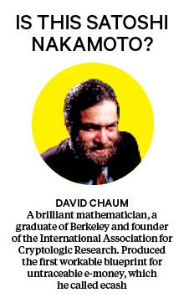

Chaum’s anonymous e-cash
1983!
blind signature primitive
Alice generates coin
Alice obfuscates coin identity
Bank signs obfuscated coin
sealed envelope analogy
5
Notes:
-father of Tor, E-cash, secure electronic voting
-blind signature primitive – two party protocol to create digital signature without signer knowing the input
-Here's the basic idea of blind signing in Chaumian e-cash:
Let's suppose that a central issuer (Chaumian e-cash is centralised) has an account in my name with a value of 10 dollars. In order to "withdraw" this money as 1-dollar "bills" I begin by generating ten random serial numbers, each long enough that I can be reasonably sure no one else will generate the same numbers.
I am going to have the central issuer sign a message saying these are now worth one dollar each, only I don't want the issuer to know which bill is which (otherwise they could just match up outgoing and incoming serial numbers to know who I spent it with, since Chaumian e-cash can only be spent once before it has to be re-issued).
So in addition to the serial numbers I also choose secret 'blinding factors' and combine them with my serial numbers. I give these blinded serial numbers to the central issuer, and they sign each one with their 1-dollar key (they have different keys for different denominations) and reduce the amount in my account with them accordingly. They know how many 1-dollar bills they signed, but they don't know what serial numbers were on each bill they signed.
Now, the trick with "blind signing" comes in. Because of how blind signing works, I can now remove the blinding factor, but I still have a valid signed message which can be verified using the issuer's public key. This gives me a signed one dollar bill with its own serial number that the bank doesn't know (but they do know how many one dollar bills they have signed, because each one can only be un-blinded to a single serial number).
Now, to spend the bills to someone else, I simply show them the un-blinded, signed serial number. They must now immediately "cash in" this token by going to the central issuer and showing them the signed serial number. The central issuer verifies the signature using their "1 dollar" key, records the serial number, and credits the new person's account. From their perspective, this dollar is indistinguishable from any other they have issued in the past.
However, if someone else shows up and tries to cash in the same dollar again, they will not honour it because they have already recorded the serial number as spent. You also cannot spend a $1 serial number as a $50 serial number because $50 serial numbers use a different key.
More details about e-cash, including an "offline mode" that relies on trusted hardware, can be found here. They use a different method of ensuring a $1 bill is not spent as a $50 bill--I don't remember which variant is whose but there are several of them which basically accomplish the same thing in slightly different ways.

Slide 7
E-cash
Alice spends coin
Bob cashes coin from bank
unlinkability?
double-spend?
disadvantages:
centralization
interactive protocol
6

Slide 8
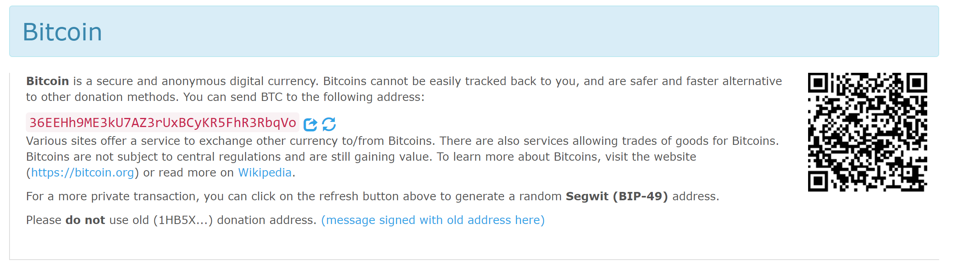


Deanonymization
Wikileaks (link)
best practice: new address
unlinkability?
5
8
3
6
Single
transaction
shared spending = joint control, ownership
transitive linking
7

Slide 9
Change address
5
8.5
3
6
.5
change address?
guesswork
8
Notes:
-if Alice had 10000 BTC at an address, the bigger transfer would have been to a change address
-a better guess would be that if the teapot had cost 0.5 BTC, Alice would probably not have had to combine two different inputs to pay for it

Slide 10
Idioms of use
idiosyncrasies of wallet software
early versions of Bitcoin Core
‘A Fistful of Bitcoins’
change address is generally fresh
easy to evade
false positives
manual oversight
clustering
real world identities
9
Notes:
-early versions of Bitcoin Core always put change address as the first output
-once you’ve clustered all addresses, you can make guesses about real world identities

Slide 11
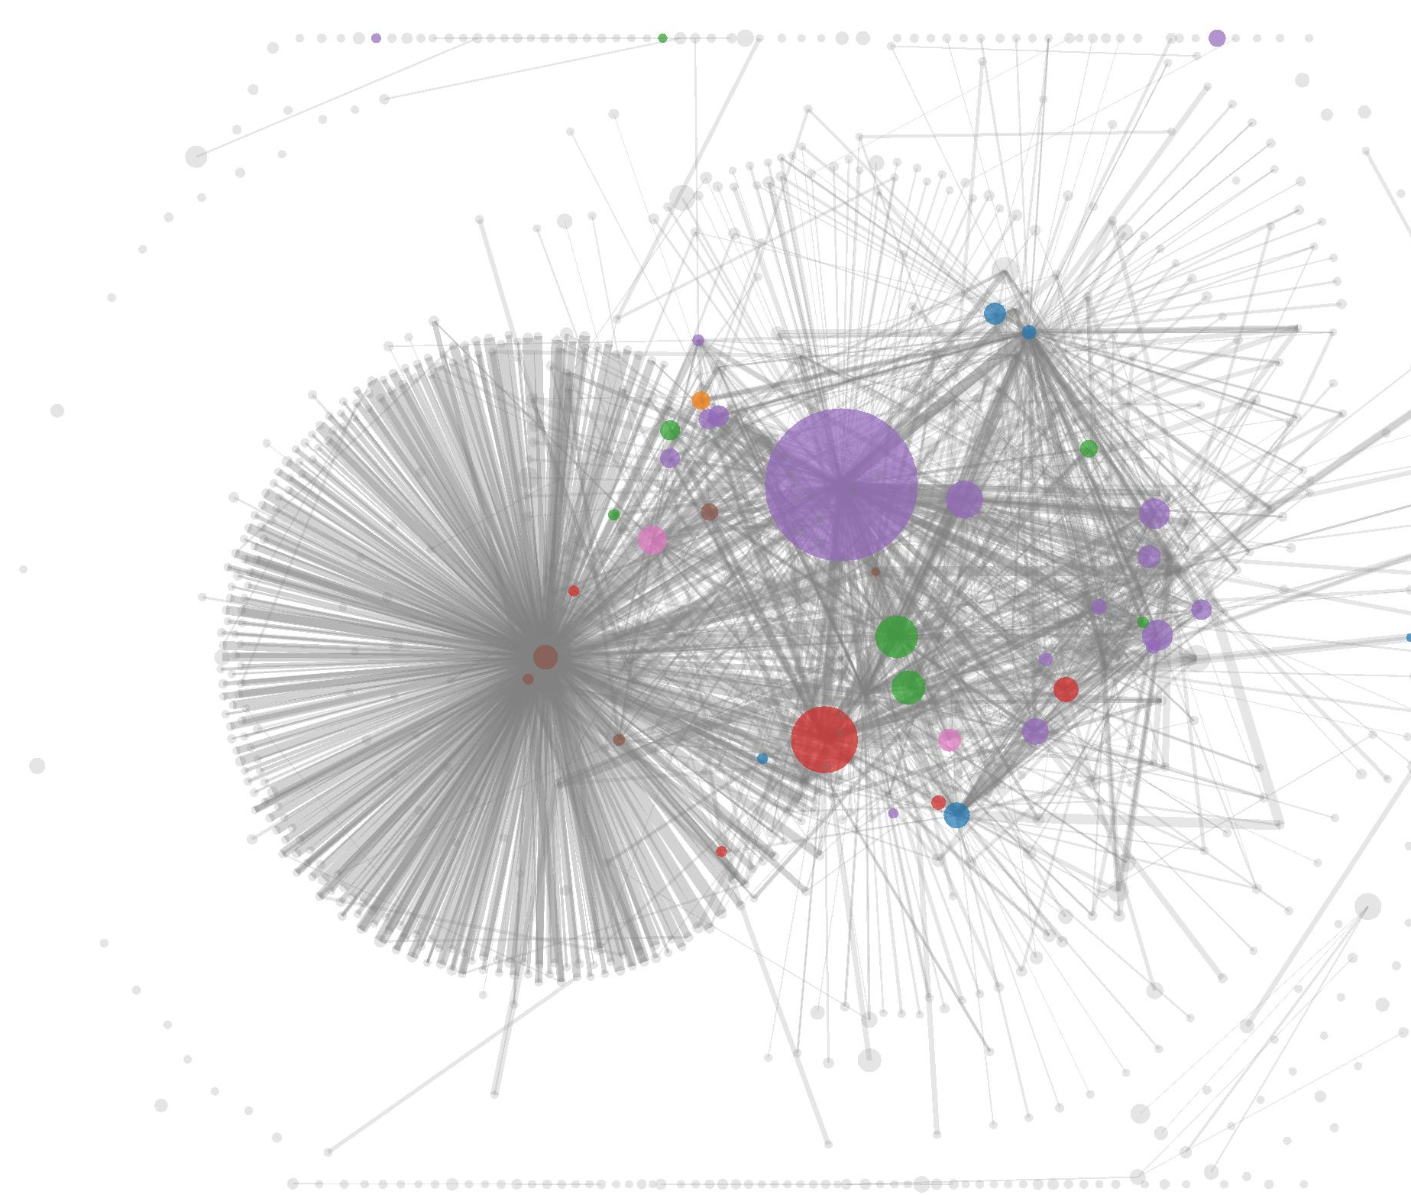
Real world identities
Mt Gox
Satoshi Dice
10
Notes:
-Mt Gox, largest volume of transactions back in 2013
-Satoshi Dice – very very large quantity of small value transactions

Slide 12
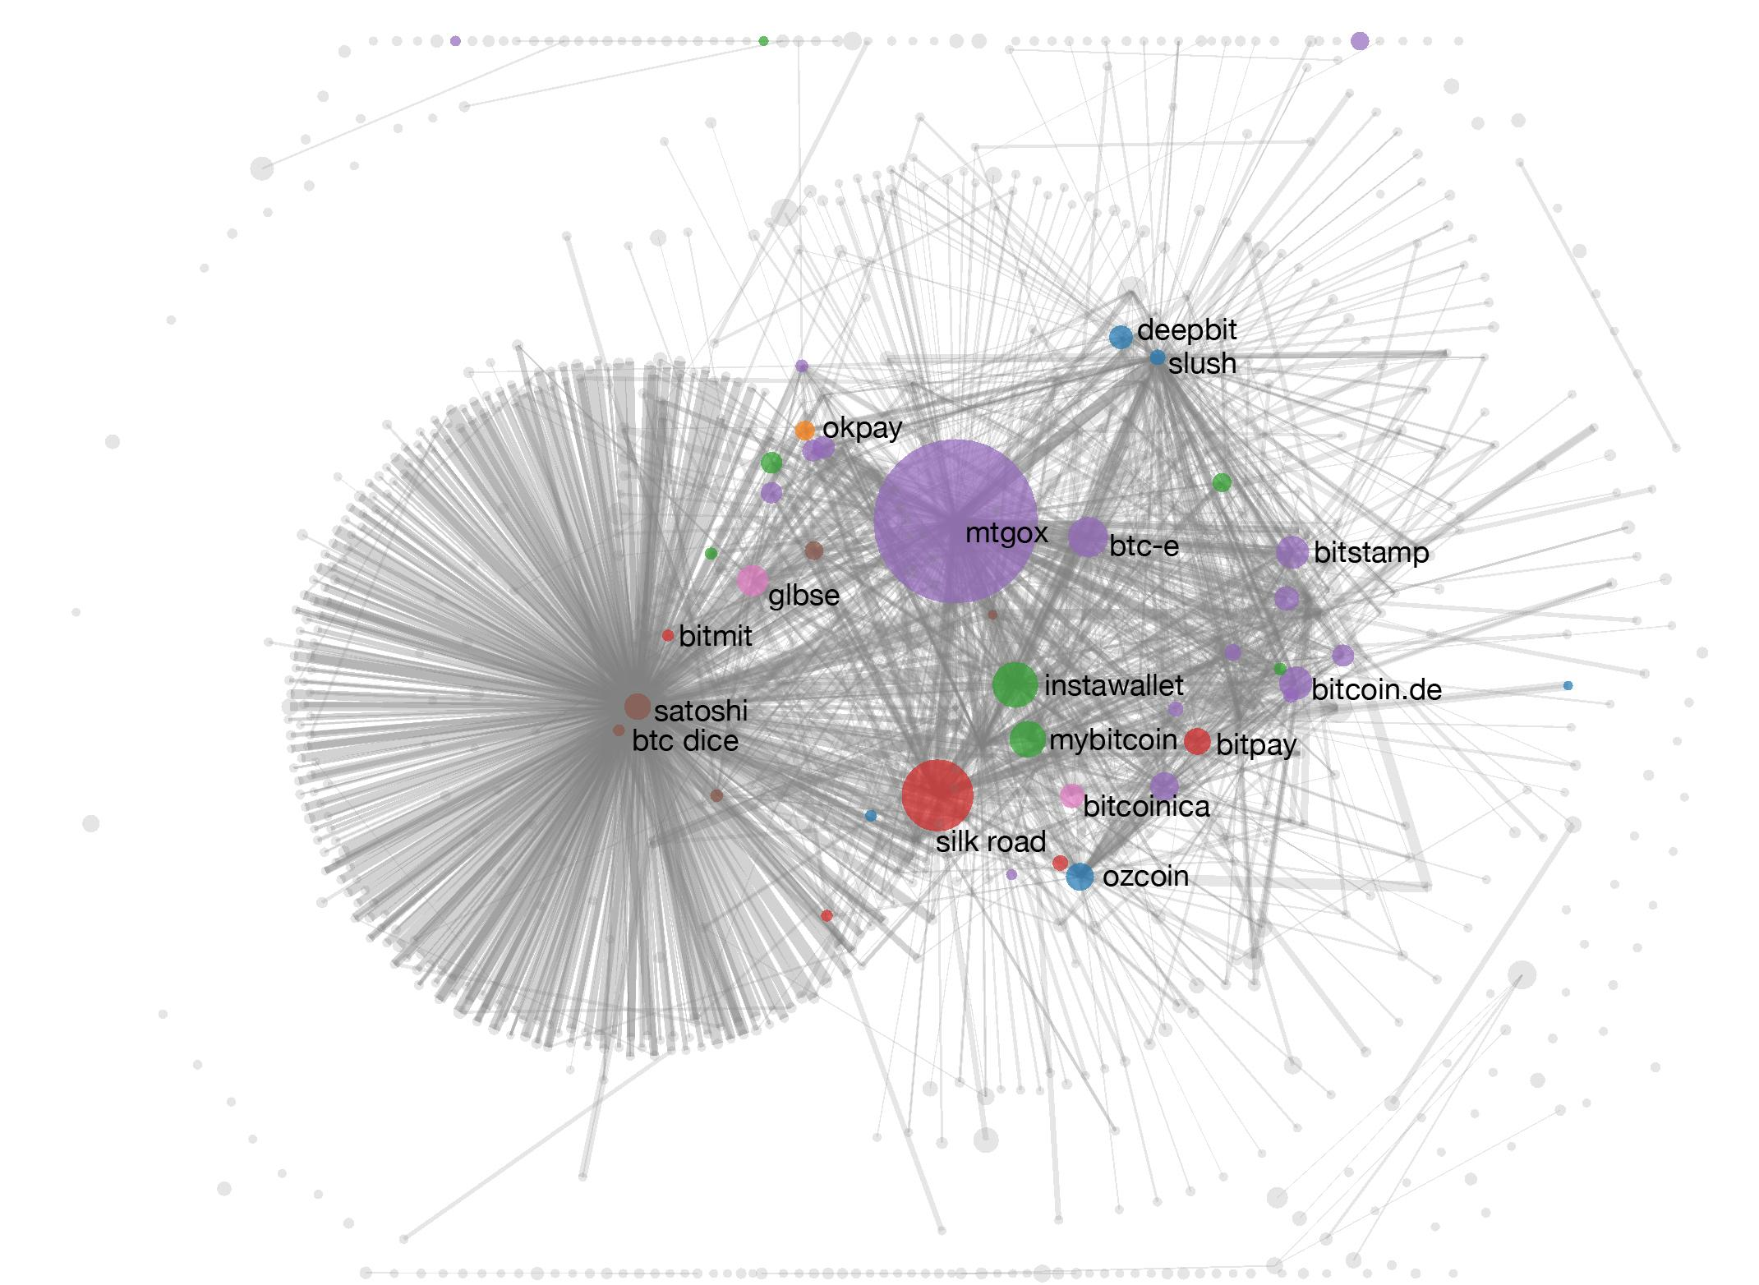
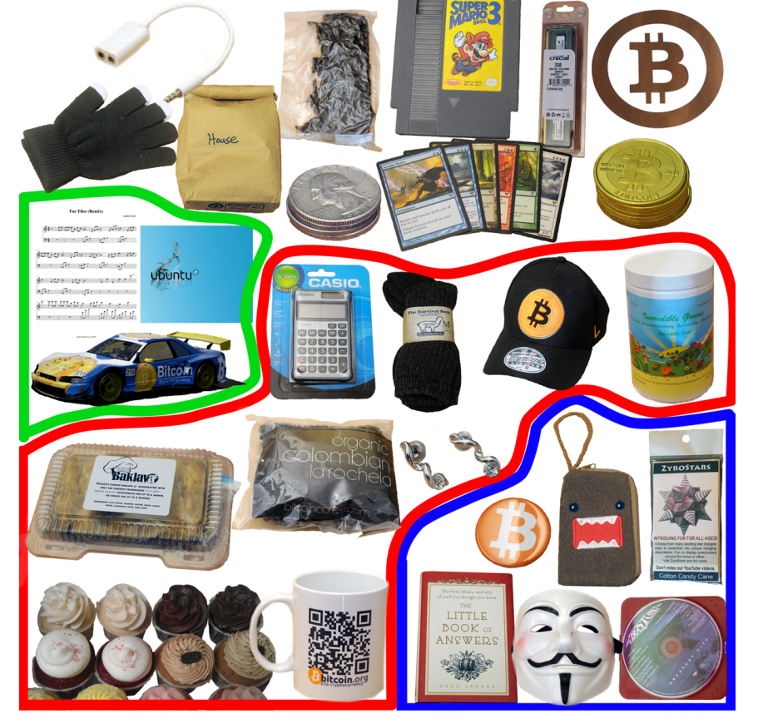
Real world identities
tagging via transaction
344 transactions
Mining pools
Wallet services
Exchanges
Vendors
Gambling sites
11
Notes:
-go to websites to get addresses for each merchant or exchange?
-but they give fresh addresses!
-instead, transact with them, and trace that address, see which cluster it ends up in!
-tag entire cluster with identity then

Slide 13
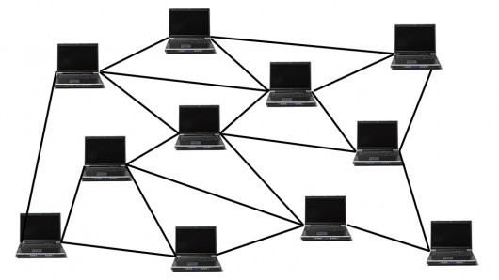

Deanonymizing users
direct transactions
centralized service providers
carelessness
the ‘time’ factor
network layer deanonymization
“The first node to inform you of a transaction is probably the source of it.” – Dan Kaminsky, 2011
Tor
12
Notes:
-directly transact with someone, you know one of their addresses now!
-service providers are usually centralized and most flows ultimately pass through them
-many of them are legally required to ask for your identity (or physical address)
-attacks become better with time as new techniques evolve and new information becomes available
-carelessness – posting one of your addresses in a public forum
-Dan noticed that when a node creates a transaction, it connects to many nodes at once and broadcasts the transaction. If sufficiently many nodes collude with one another, they can figure out the first node to broadcast the transaction.

Slide 14
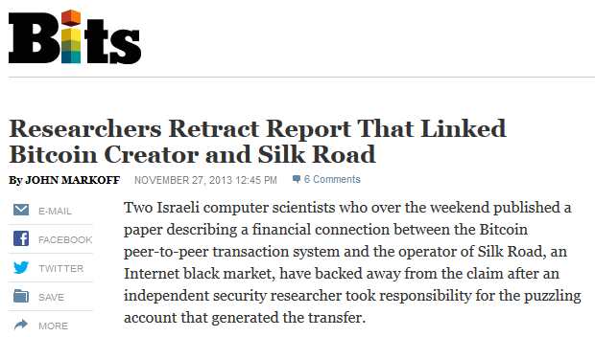
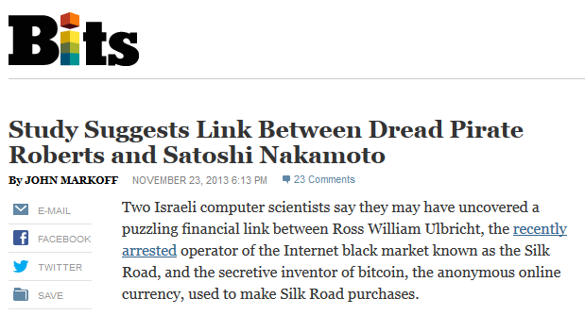



Online wallets
coins input typically different from output coins
13
Notes:
-just like real bank – serial numbers for coins/notes will be different from the two.

Slide 15
Online wallets
no guarantee of mixing
internal records
security and legal compliance
identity record
just like traditional banks!
extra risk!
14
Notes:
-even if they mix your funds, they keep internal records
-reputable wallets even have customer identity on record
-better than no privacy!
-from point of view of a stranger, we have *some* privacy
-but blockchain is public – so if something goes wrong (e.g. internal records get hacked), privacy risks may be worse than traditional banking system

Slide 16
Homework
Chap 6: Bitcoin and Anonymity Bitcoin and Cryptocurrency Technologies: A Comprehensive Introduction
The future of electronic currency (link)
5 stupid things Dread Pirate Roberts did… (link)
Anonymity is dead (link)
15

Slide 17
Further reading
How Digicash blew everything (link)
16

